Slide 1
Paper Series, 1st Call

Slide 2
The series
Addressing young Arab scholars and early-career UN staff
Aims to encourage structured dialogue over “wicked” problems in the Arab region
Aims to foster the discussion on essential issues and evidence-based policies for accelerating the implementation of the SDGs
Be provocative and jump-start a conversation over ‘structural” challenges and opportunities.

Slide 3
Building on the similarities between theArab Countries for fostering sustainable development
Culture and development | 2
Economics | 11
Gender | 4
Human development/education | 5
Natural resources | 5
Conflict and peace | 2
Policy making | 4
Science, Technology and Innovation (STI) | 5
Statistics | 1
Transport | 2
Urban Development | 5
 | 46
62 Abstract
46 initial review
2 reviewers for each abstract:
12 shortlisted: Lebanon, Algeria, Egypt, Palestine, ESCWA, Qatar

Slide 4
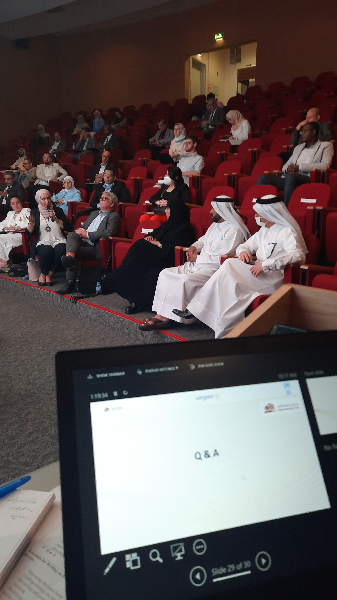
9 papers submitted by the deadline
  Editorial review
Perfection workshop, September 2022
  Editorial review
3 papers in the AFSD 2023, Beirut, March 2023
8 papers will be published with QU Press

